Slide 1

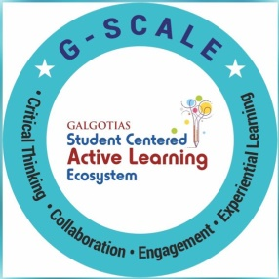
Syntax of Python – Writing and Running Python Programs
Session No.: 3
Course Name: Python Programming
Course Code: - E1UA311C Instructor Name: Pooja Vajpayee
Duration: 50
Date of Conduction of Class:

Slide 2
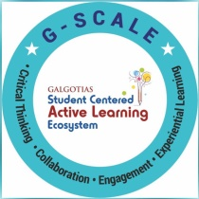
Recap
Python – History, Features

Slide 3
Opening Question
“If English has grammar rules, what happens when we break them?

Slide 4
At the end of this session students will be able to
LO1: Understand basic Python syntax rules
LO2: Write and Run Python programs

Slide 5
Session Outline
1. Python Syntax – Writing and Running
2. Learning Outcomes
3. Writing & Running Program
4. Statements & Indentation
5. Activity
6. Conclusion & Closure

Slide 6
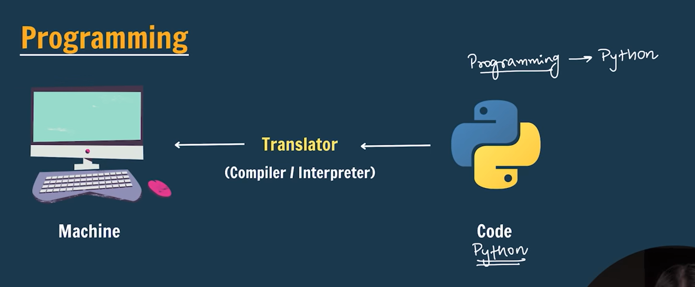
Understanding Programming

Slide 7
Writing Python Programs
You can write Python code using:
• IDLE (Python’s built-in editor)
• Text editors (VS Code, PyCharm, Notepad++)
• Online editors (Colab, Jupyter, Programiz)
Quick Activity: Which editor have you used before?

Slide 8
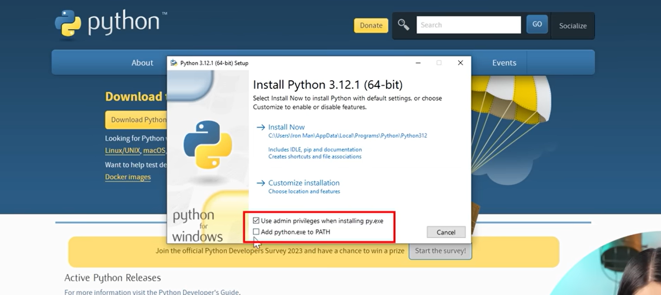
How to Install Python in Windows
Go to Google and type download python and click on first result: https://www.python.org/downloads/
Check the two boxes and click on install now
To check for successful installation, type on terminal: python --version

Slide 9
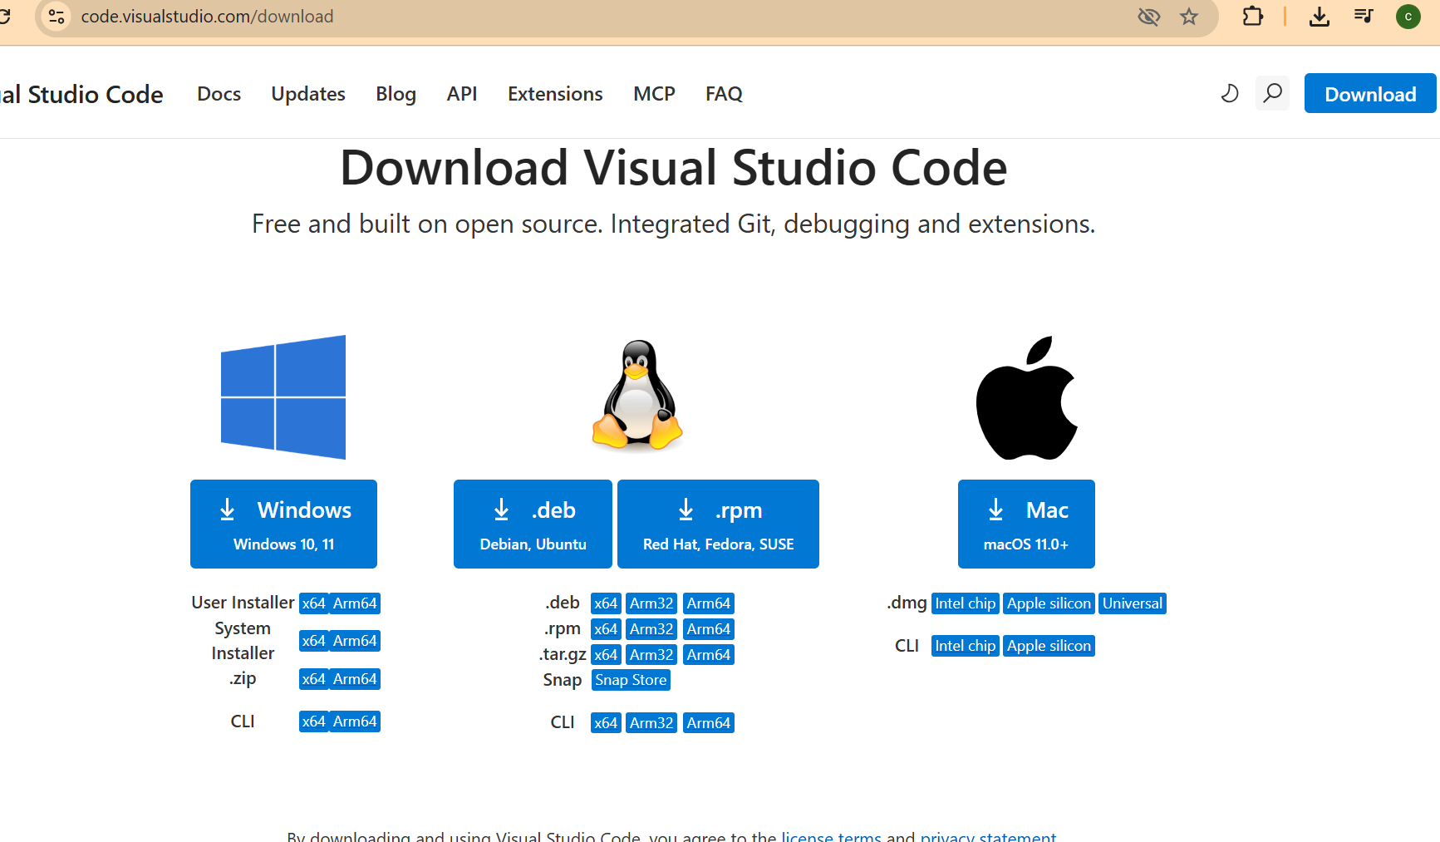
How to Install VS CODE in Windows
Go to Google and type download VS code and click on first result: https://code.visualstudio.com/download
Check all check boxes during installation
Once Python is installed on your system, you can:
Write and run Python programs

Slide 10
Python Syntax
  Syntax = rules that define how Python code is written
  • Python is case-sensitive, Var is different from var/vAr
  • Uses indentation instead of braces {}
  • Simple and readable structure

Slide 11
Statements in Python
A computer program is a list of "instructions" to be "executed" by a computer.
In a programming language, these programming instructions are called statements.
Example
print("Python is fun!")
In Python, a statement usually ends when the line ends. You do not need to use a semicolon (;) like in many other programming languages (for example, Java or C).
Many Statements
Most Python programs contain many statements.
The statements are executed one by one, in the same order as they are written:
Example
print("Hello World!")
print("Have a good day.")
print("Learning Python is fun!")

Slide 12
Statements in Python
Semicolons (Optional, Rarely Used)
  Semicolons are optional in Python. You can write multiple statements on one line by separating them with ; but this is rarely used because it makes it hard to read:
  Example
  print("Hello"); print("How are you?"); print("Bye bye!")
However, if you put two statements on the same line without a separator (newline or ;), Python will give an error:
  Example
  print("Python is fun!") print("Really!")
  Result:
  SyntaxError: invalid syntax

Slide 13
Indentation in Python
Indentation refers to the spaces (most common use is four, but it has to be at least one) at the beginning of a code line.
Indentation shows blocks of code
Example:
if 5 > 2:
print('Five is greater than two')

Slide 14
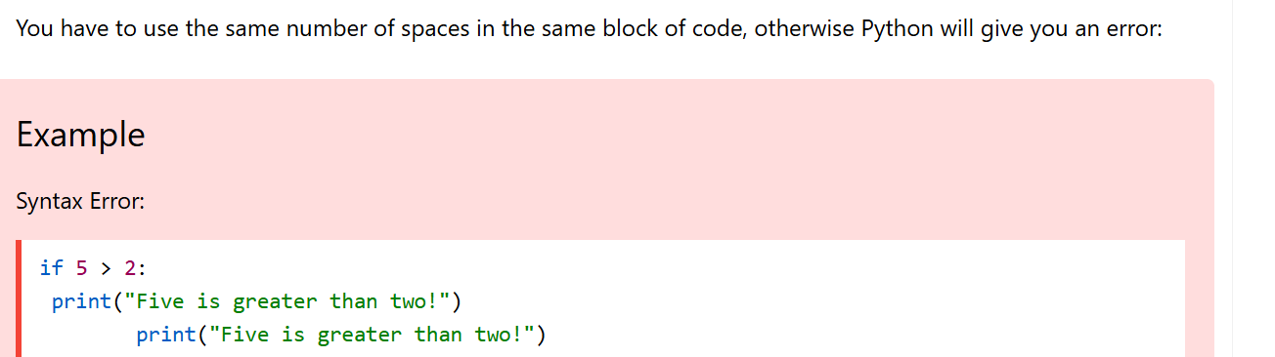
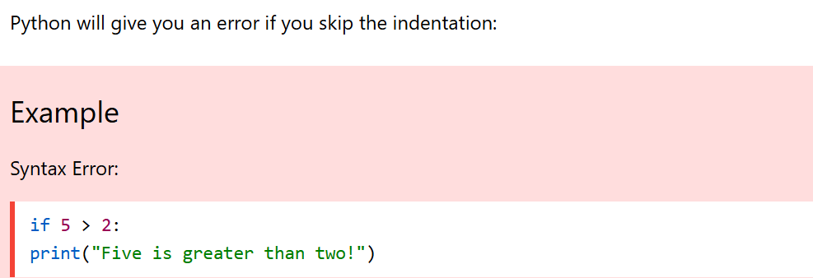
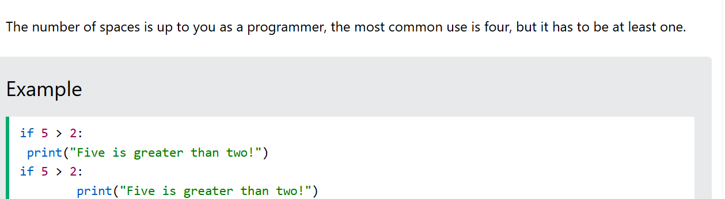
Indentation in Python

Slide 15
First Python Program
Example:
print('Hello, World!')
Key points:
Save it as P1.py (filename.py)
• print() is a function
• Text (string) is written inside quotes

Slide 16
Updated First Python Program
Example:
print ("hello world")
print ("hello", "world")
print("hello")
print("world")
print(23)
print(23+35)
hello world
hello world
hello
world
23
58

Slide 17
Running Python Programs
Method 1: Using IDLE → Run Module (F5)
Method 2: VS Code → click Run
Method 3: Online compilers

Slide 18
Common Syntax Errors
• Missing colon
• Wrong indentation
• Misspelled keywords
• Missing quotes

Slide 19
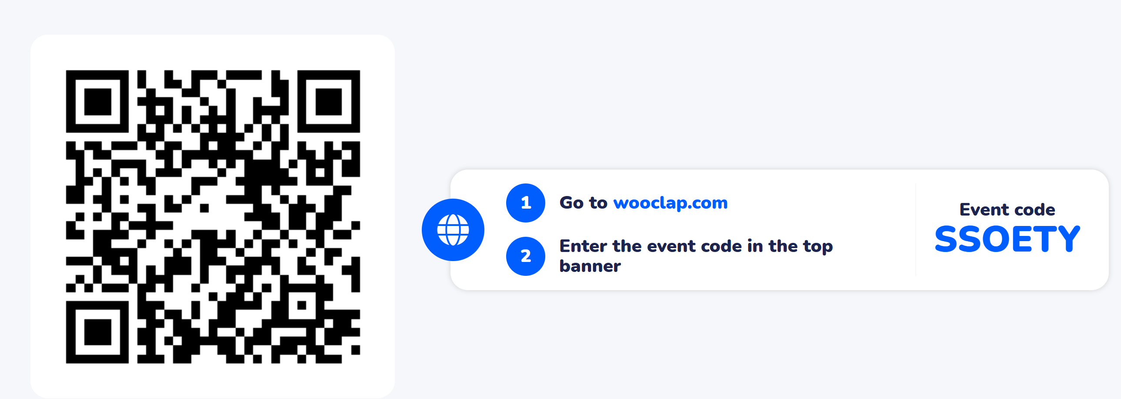
Learning Activity

Slide 20
Summary of Key Points
Syntax = rules that define how Python code is written
A computer program is a list of "instructions" to be "executed" by a computer. In a programming language, these programming instructions are called statements.
Indentation refers to the spaces (most common use is four, but it has to be at least one) at the beginning of a code line. Indentation shows blocks of code
Install Python and VS code.

Slide 21
Attainment of LOs in alignment to the learning activities: outcomes (1-2)
Understand basic Python syntax rules
Write and Run Python programs

Slide 22
Information about the next lesson
Keywords, Identifiers, Variables, and Data Types

Slide 23
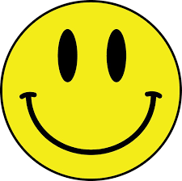
Review and Reflection from students

Slide 24
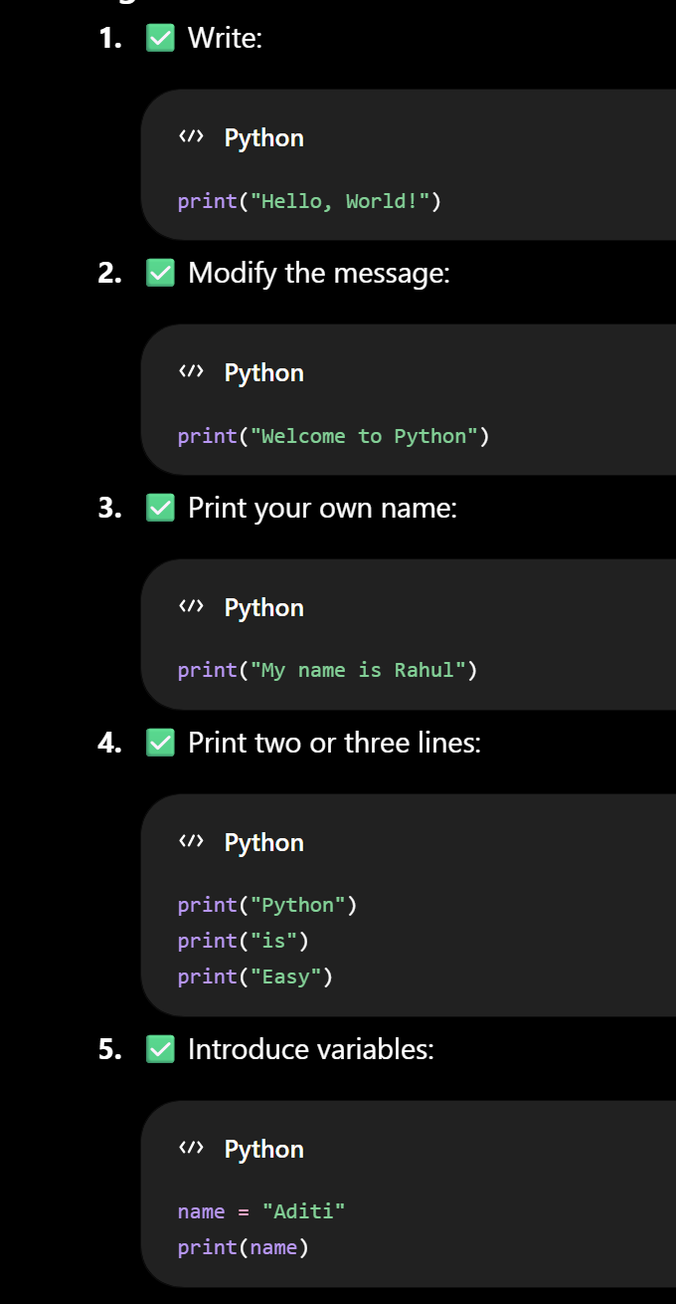
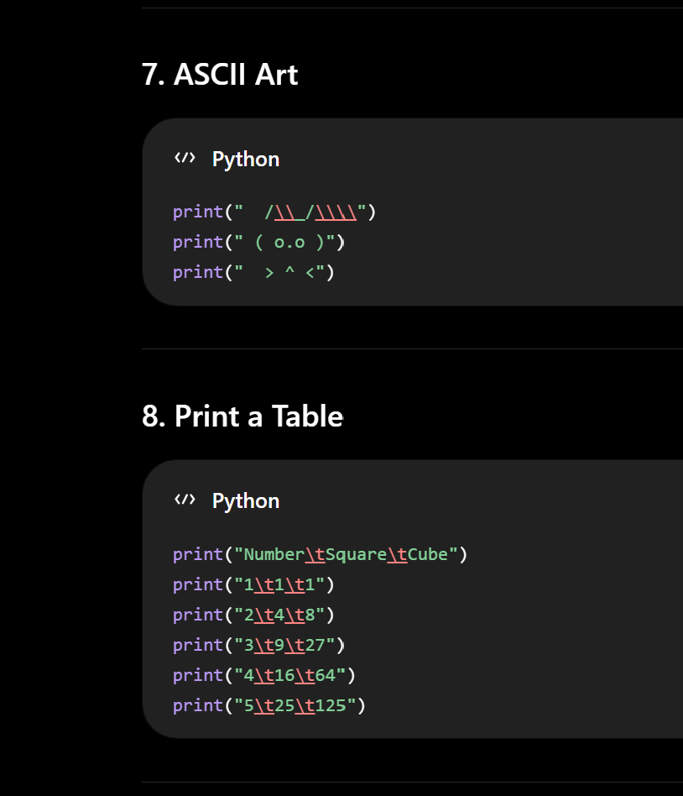

Slide 25
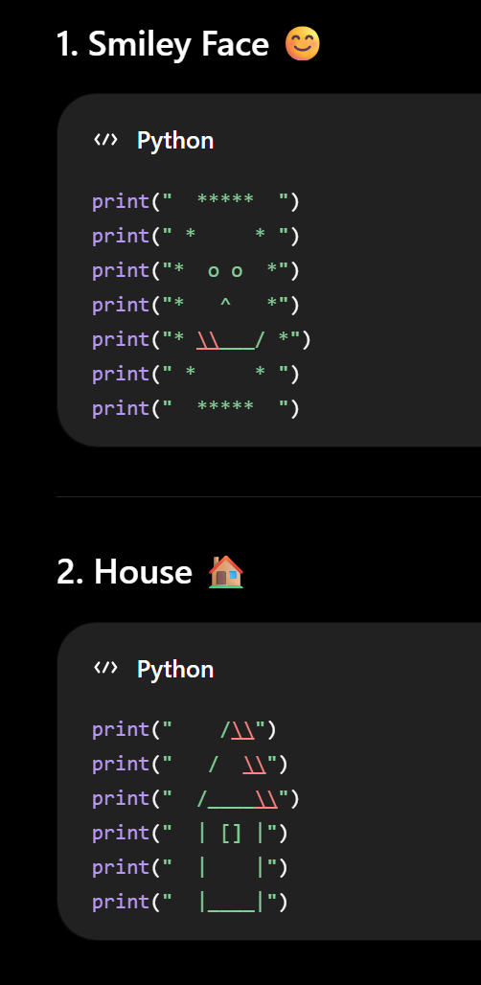
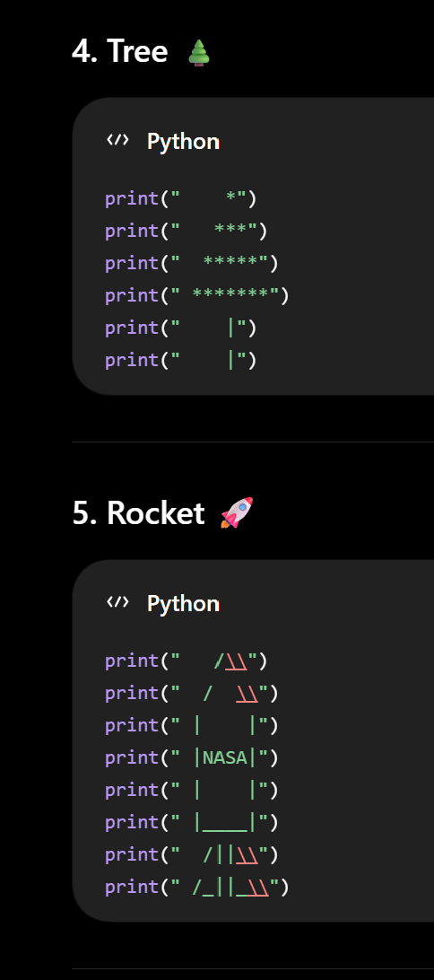
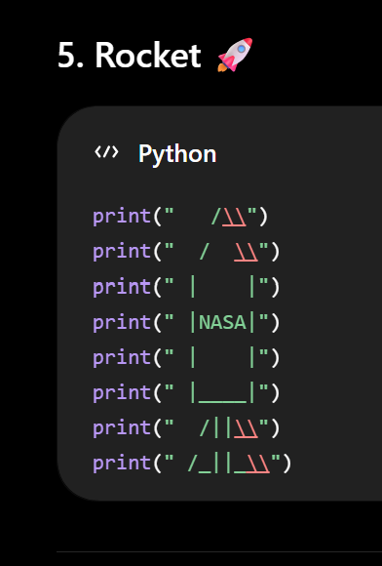

Slide 26
